Slide 1
Amerijet International Airlines
www.Amerijet.com
Updated 04/30/2024

Slide 2
Amerijet Introduction
Leading provider of high-quality air cargo services
Scheduled air-cargo service operation
Long-term ACMI lease (Aircraft, Crew, Maintenance & Insurance) & CmI (Crew, Maintenance & Insurance) contracts
Long-term and Ad-Hoc Charters
CRAF Carrier – Government Contracts including for Global Heavyweight and Commercial Multimodal
Established global GSA (General Sales Agent) network
Regional ground distribution partner network
Long-standing relationships with global forwarders and airlines
Providing transparent cargo solutions for customers from multiple industries
High customer loyalty
Established leadership team

Slide 3
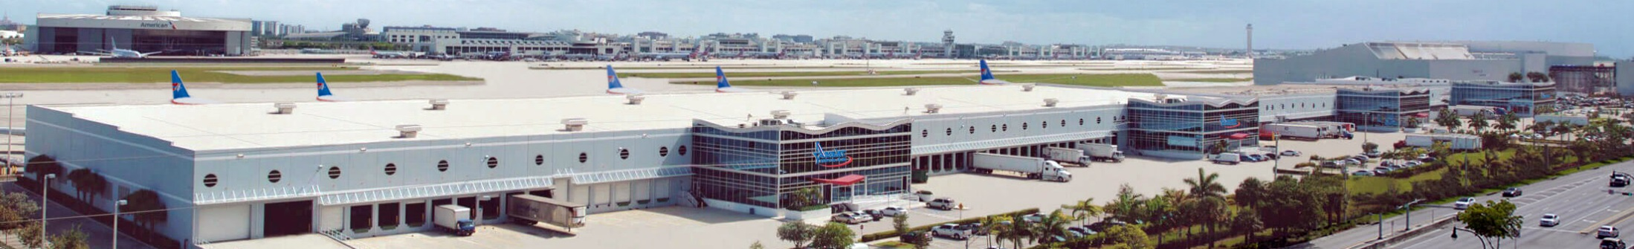
Amerijet History
1974
Started operations in 1974
Amerijet was flying overnight courier services, operating a fleet of Falcon 20s
Amerijet purchased its first Boeing 727-100 to start its scheduled all-cargo operation serving Mexico and the Caribbean
Continued expanding into Central America and opened additional GSA offices in Asia and Europe
Amerijet focused on facility and fleet expansion and deployed its first Boeing 767-200 freighter
1980s
1990s
2000s
2010s
Today

Slide 4
Amerijet Today
Today
Amerijet operates scheduled freighter service throughout the Caribbean, Mexico, and Central & South America. The company provides ACMI, and CMI long and short-term charters for customers worldwide.
Completed Expansion Initiatives:
Fleet growth (B767-300 freighters)
Global ETOPS (Extended-range, Twin-engine, Operational Performance, Standards)
Certification
Start of scheduled service European route
CEIV (IATA Center of Excellence for Independent Validators in Pharmaceutical Logistics)
Certification & Re-certification

Slide 5
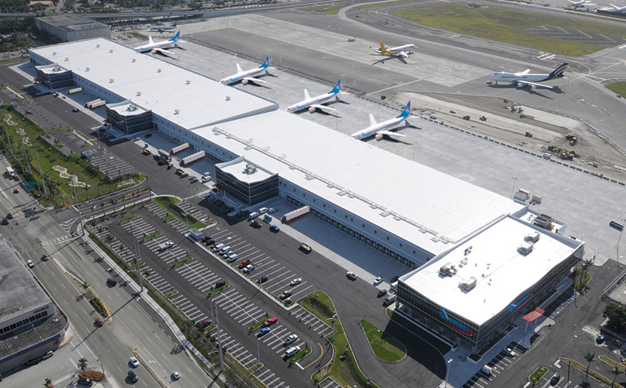
Amerijet International Airlines – Miami Hub
Amerijet’s facility located at the Miami International Airport includes:
  360,000 square foot (33,500 m²) automated warehouse
    Including 40,000 square foot (3,700 m²) temperature-controlled handling center
  Exclusive ramp access for aircraft handling and
  parking
  49 dry cargo, 12 cold storage, and three (3) dedicated pharmaceutical receiving doors
  Landside and airside acceptance of palletized freight and containers to streamline cargo flows and reduce receiving times

Slide 6
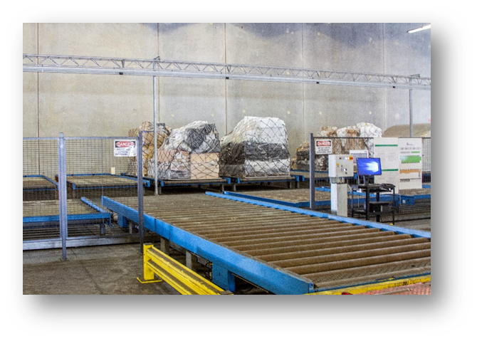
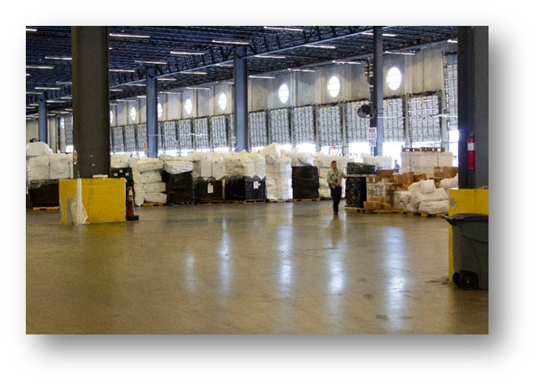
Amerijet International Airlines – Miami Hub
Facility was designed for high volume throughout
Integrated import/export warehouse
Freight weighing and dimensioning stations
Automated ULD management and high racking warehouse
ULD by-pass roller systems (acceptance to ramp)

Slide 7
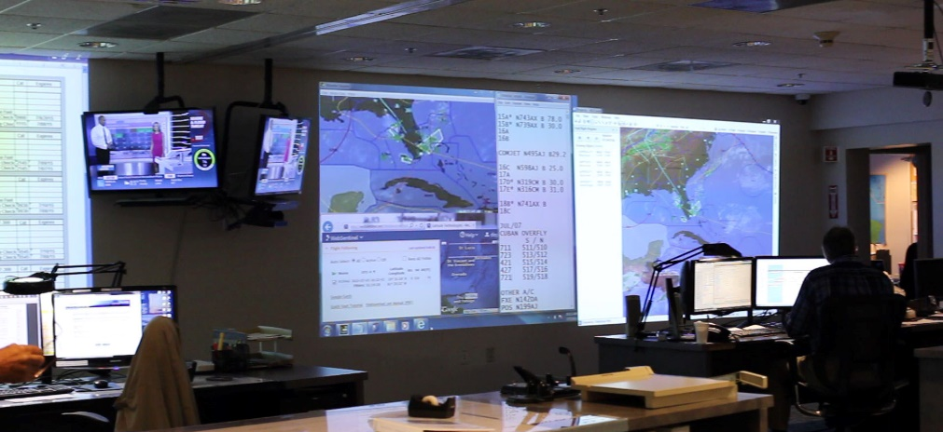
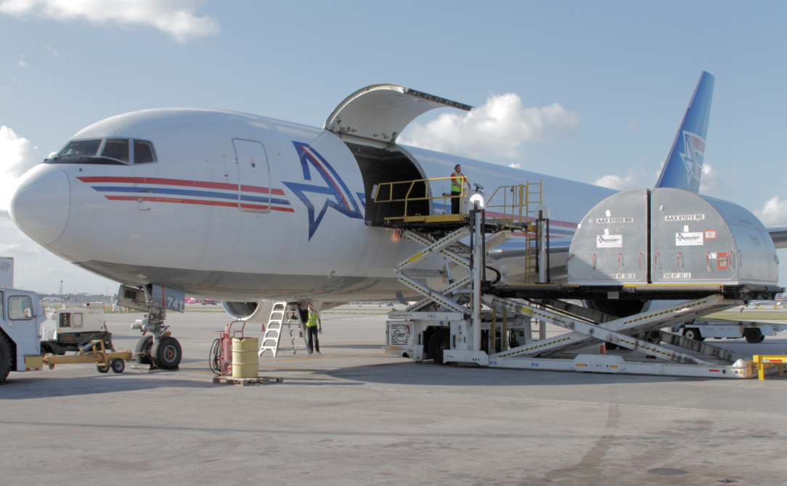
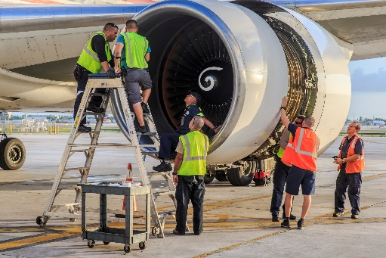
Amerijet International Airlines - Corporate Offices
Amerijet's corporate offices located at the Miami International Airport houses all airline-related functions:
  Operations control center
  Maintenance department
  Flight operations, dispatch and crew
  Ramp operations
  Corporate and warehouse security
  Dry and refrigerated trucking dispatch

Slide 8
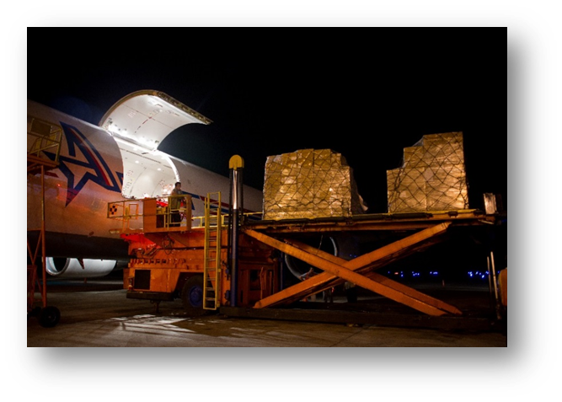
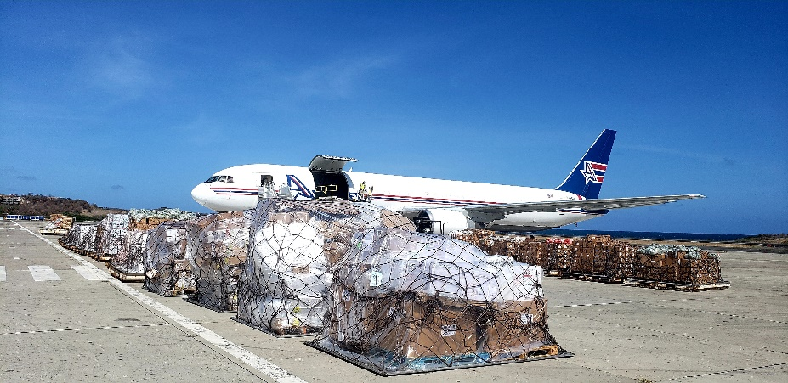
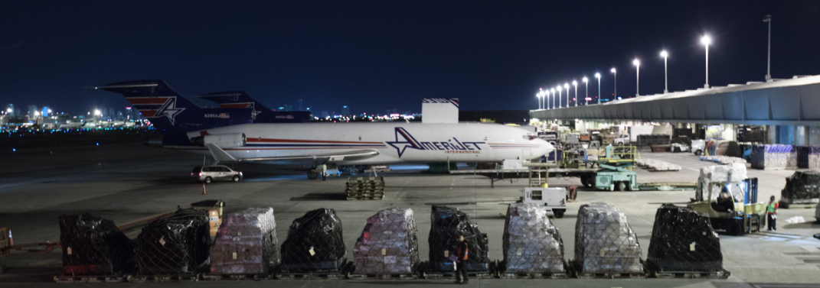
Long Term ACMI/ Schedule Charters & CMI Contract
Amerijet operates multiyear ACMI, CMI long and short-term charter contracts for customers in various industries.

Slide 9
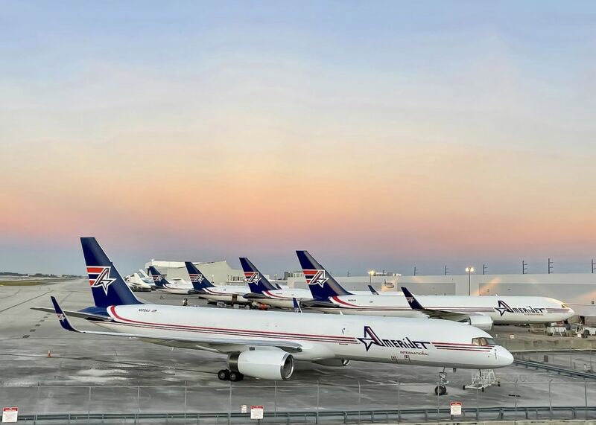
Amerijet Fleet of Freighter Aircraft
Amerijet operates a fleet of Boeing 767-300 freighters.

Slide 10











Our Product Portfolio
General Freight
Pharmaceuticals
Active and Passive
Temperature Controlled Food Products
Oversized and Project Freight
Department of Defense
Dangerous Goods
Valuables
Live Animals
Human Remains
Charters and ACMI
Notes:
Any claim impacts the airline’s brand and reputation.
Especially when shipping high value goods such as pharmaceutical products
Pharmaceutical products have to be protected from theft, tamper and temperature as well as humidity

Slide 11
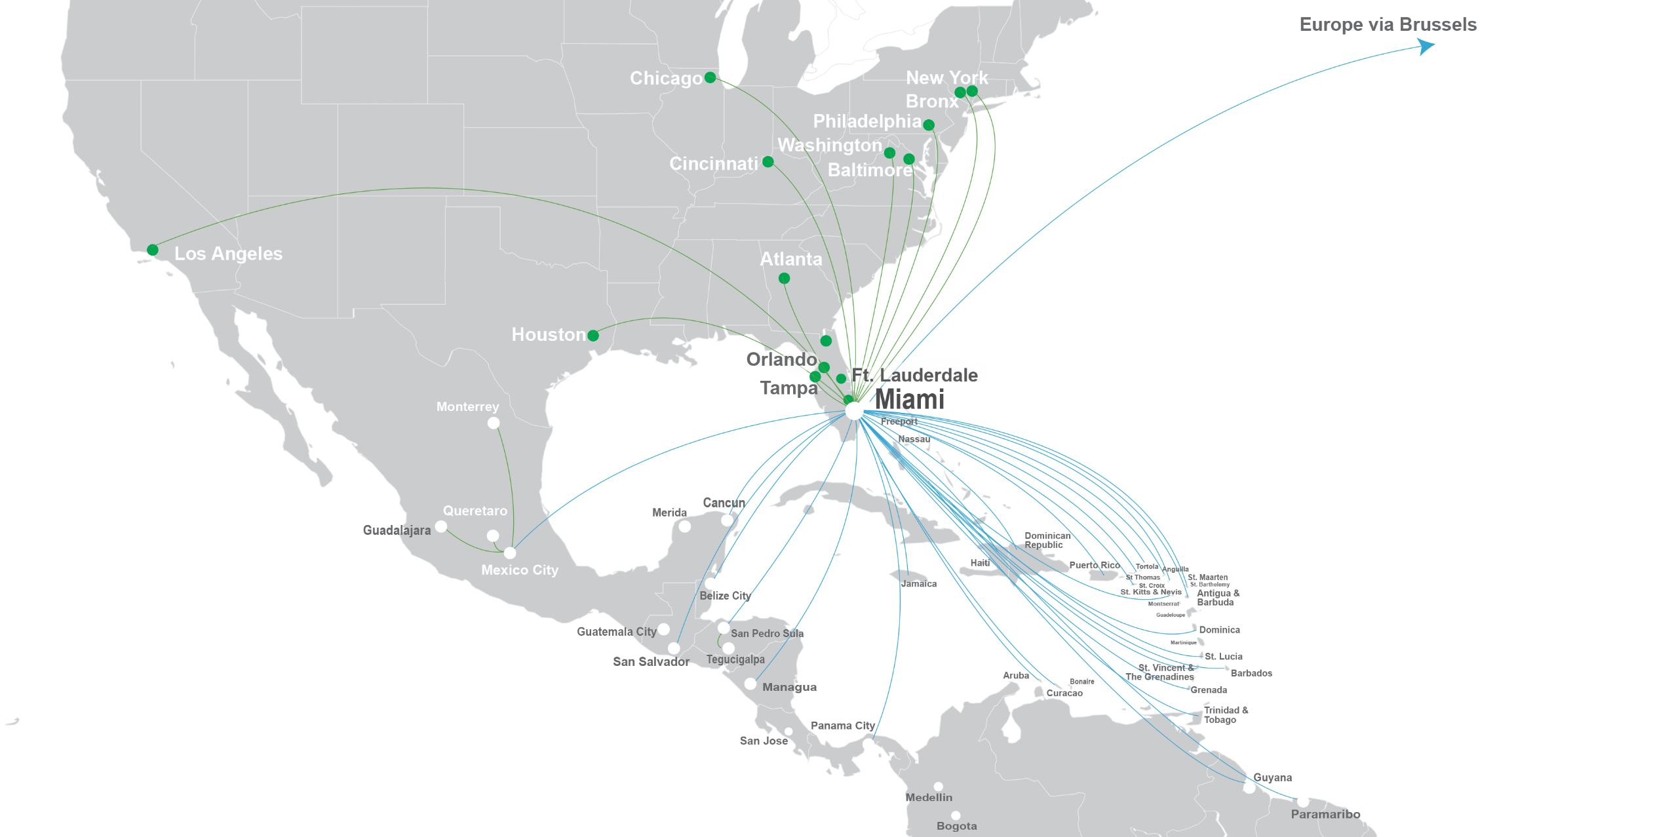
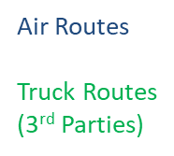
Amerijet Scheduled Service Region

Slide 12
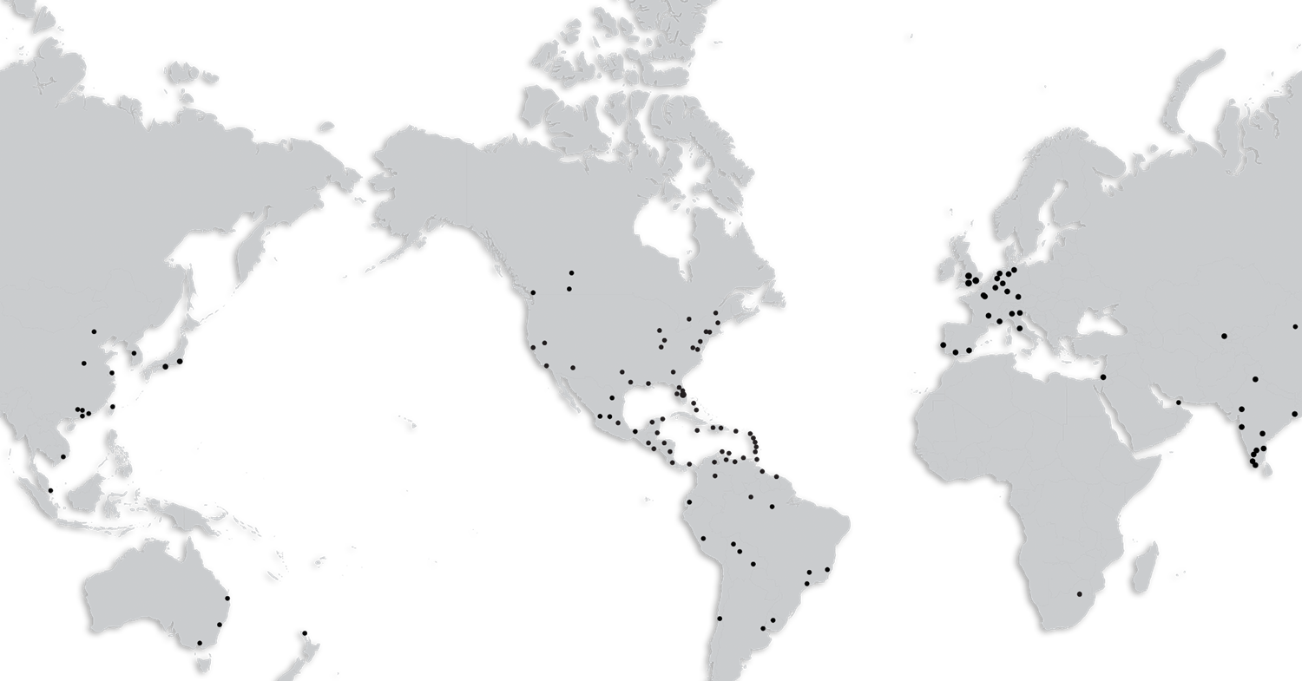
Worldwide Representation
Amerijet’s global network provides seamless and transparent transportation solutions utilizing its company owned and operated infrastructure, devoted GSA and long-term interline contracts.

Slide 13


Our Strengths
Leading cargo market share in 67% of Amerijet’s service region
Amerijet’s market share by country⁽¹⁾
  11 countries: > 80%
  16 countries: 50-79%
  2 countries: 30-49%
  3 Countries: < 29%
Diversified customer mix
  72% Forwarders
  22% Direct shippers
  6% interline partners
Established partnerships
  Global GSA network
  Ground service partnerships
  (1) WorldACD MarketShare, based on available carrier reporting. Time Period: CY2023 TYD June 19

Slide 14

Amerijet CEIV Certification
First U.S. cargo airline to receive the IATA CEIV-Pharma Certification in June, 2017
First carrier in the U.S. to obtained re-certification in August, 2020
Amerijet is continuously reinforcing internal processes through training, collaboration, and partnering with like-minded suppliers. Amerijet's Quality Management program includes:
  Service level agreements
  Documented training programs
  Quality metrics
  Audits & self-inspection
  Risk assessment
  Corrective & preventative action program
“Amerijet is continuously reinforcing internal processes through training, collaboration, and partnering with like-minded suppliers.”

Slide 15
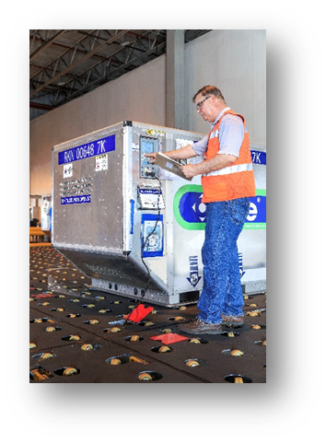
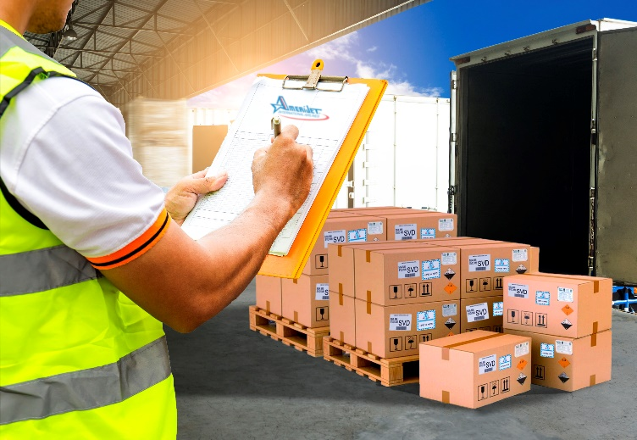
Pharmaceutical Products
Dedicated storage coolers for temperatures ranging
between:
  +15°C and +25°C
  +2°C and +8°C
  -20°C frozen/Active containers
24/Hr. Security and surveillance
Temperature controlled pharmaceuticals are vaccines, clinical trials, blood products, etc.
Non-temperature controlled pharmaceuticals are medical devices or laboratory equipment, solid pharmaceuticals such as pills, tablets, lozenges, etc.
Hazardous and radioactive pharmaceuticals are bioengineered drugs, medical waste, etc.

Slide 16
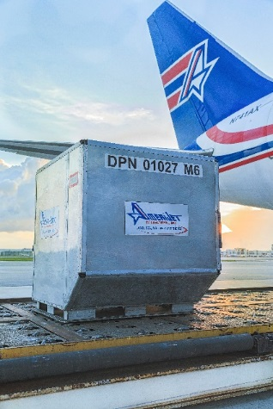
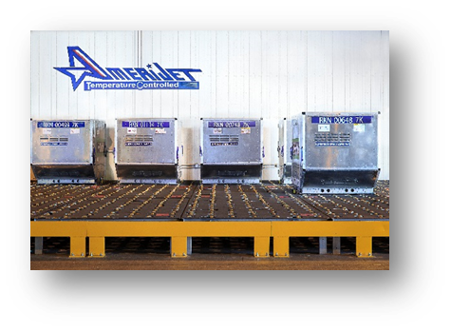

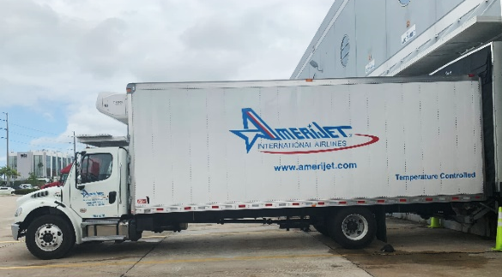
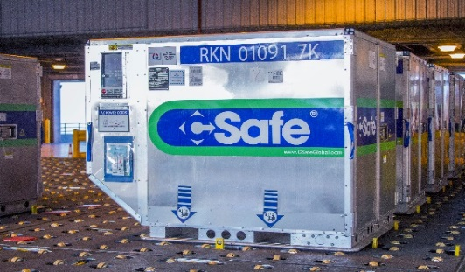
Amerijet Pharmaceutical Handling
Pre-cooling receiving area including dock doors with environmental protection
Less than 5-minutes tarmac transfers
Refrigerated trucks
Active container leasing program
Dedicated active container charging/storage
Approved utilization of temperature and data loggers
Shipment transparency/EDI - Milestone updates

Slide 17
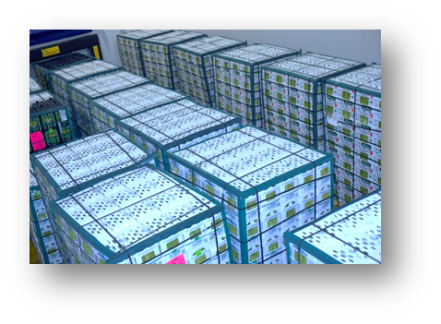
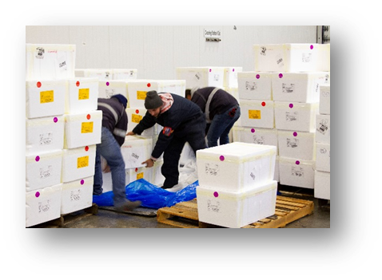
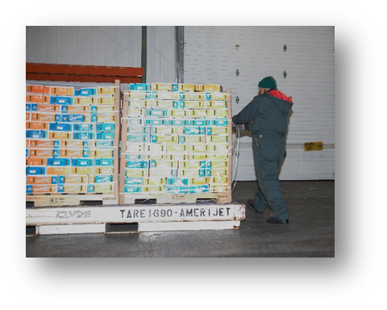
Temperature Controlled Food Products
Temperature controlled handling center
40,000 sq ft (3,700 sq meter)
Climate-controlled cooler compartments for refrigerated, frozen and chilled storage
Computerized monitoring of temperature changes and backup systems
Pre-cooling receiving area
Enclosed dock doors allow for seamless cold chain transfers from trucks to coolers
15 of 47 dock doors are dedicated for temperature-controlled shipments
24-hour monitoring, including cooler compartments

Slide 18
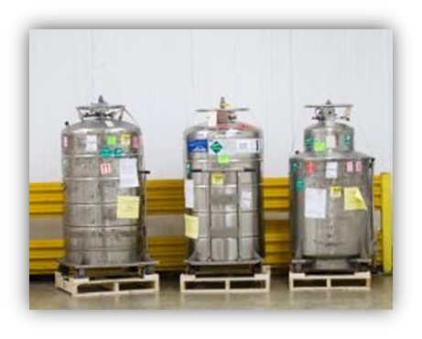
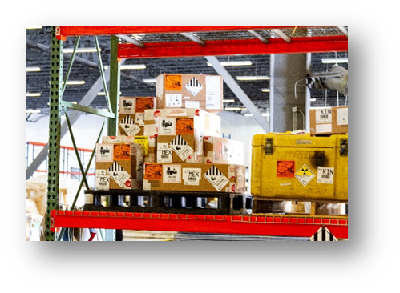
Hazardous Materials
Certified dangerous goods handling agents
Compliance with the highest safety and environmental standards
Strict adherence to IATA Dangerous Goods Regulations
  Explosives
  Gases
  Flammable liquids and solids
  Corrosive substances
  Toxic, infectious and radioactive substances
  Magnetized material
  Industrial solvents or chemicals
  Infectious substances
  Insecticides (including fertilizers, poisons)
  Used engines
  Lithium batteries (including batteries contained in equipment)

Slide 19
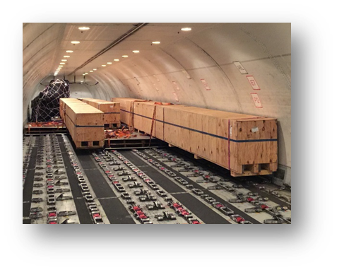
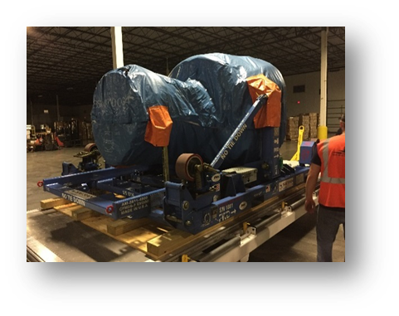
Oversized and Project Cargo
Project consulting
Flexible flight planning
Integrated RFS solutions
Industry knowledge and experience
Highest safety and environmental standards
Individual charter solutions
Various Industries:
  Oil and gas
  Automotive
  Aerospace
  Telecommunications
  Government contracts
  High tech
  Heavy construction
  Marine industry

Slide 20
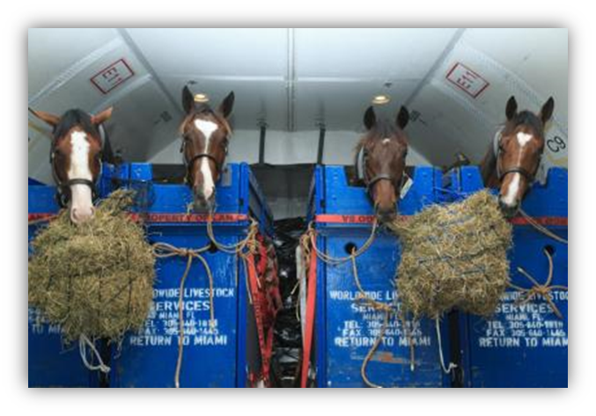
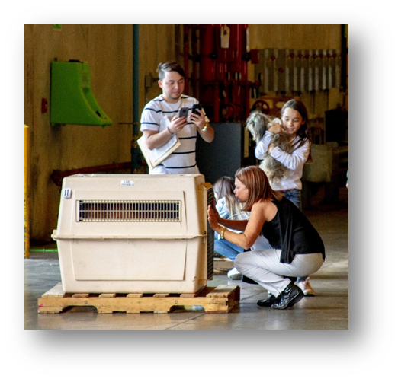

Live Animals
Dedicated live animal handling desk
Species-appropriate care
Noise-reduced and temperature-controlled handling
All animals are transported in full compliance with the IATA Live Animal Regulations
  Horses
  Livestock
  Pets
  Zoo animals
  Marine life
  *Amerijet does not transport animals for research and/or
  laboratory, science purposes.

Slide 21
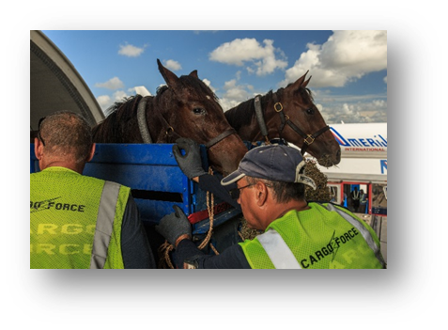
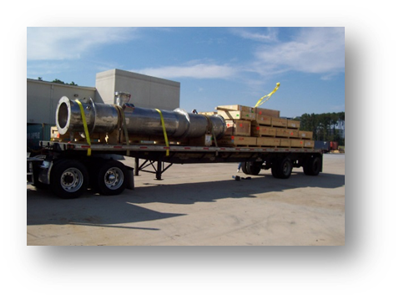
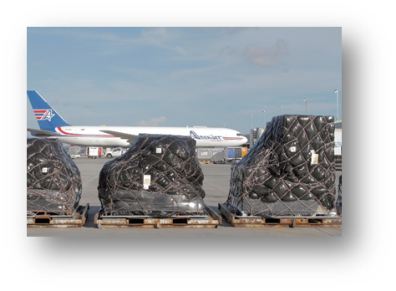
Ad-Hoc Charters
Amerijet offers U.S. domestic and international Ad-hoc charters for a multitude of industries, using a variety of aircraft including but not limited to its own fleet
  Humanitarian relief
  Project freight
  Time critical
  Live animals
  Hazardous material
  High value
  Remote destinations

Slide 22
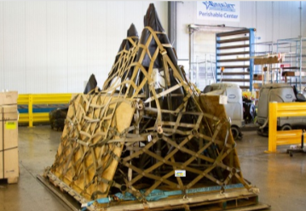
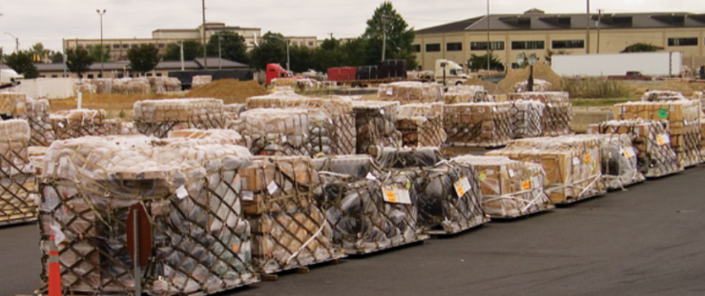
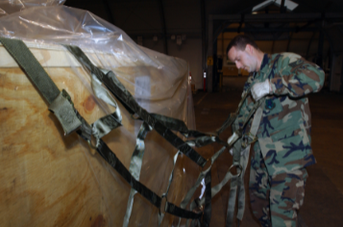
Government Programs
CRAF Carrier – Government Contracts
  DOD Global Heavyweight
  Multimodal Contract
    Strategic partnerships
    Proven global capabilities
    Safe and reliable record of performance

Slide 23
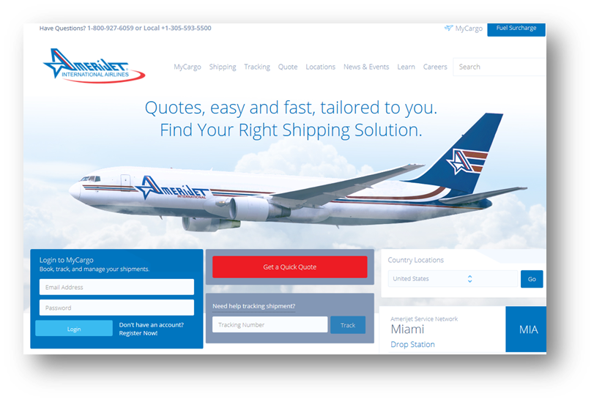
EDI and Tracking
Monitoring and tracking
Provide tracking and shipment alerts capabilities
GPS tracking devices for high value shipments
EDI
IMP standards
SmartKargo

Slide 24
Amerijet International Airlines
Thank you for your time and attention.

